Slide 1
Capstone Project: Netflix Data

Slide 2
Overview
As they hypothetical data visualization developer at Yahoo Finance! I will show the Stock profile of Netflix
In finance, a stock profile is a series of studies, visualizations, and analyses that dive into different aspects a publicly traded company’s data.
The following visualizations included in the presentation are:
The distribution of the stock prices for the past year
The actual vs. estimated earnings per share for the four quarters in 2017
Netflix's earnings and revenue in the last four quarters
A comparison of the Netflix Stock price vs the Dow Jones Industrial Average price in 2017

Slide 3
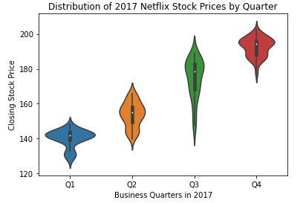
Quarterly Distribution of Netflix Stock Prices (2017)
Netflix Stock Price increased over the quarters.
At Q3 the price was volatile with price range of 130+ - 200 whilst Q4 maintained a price range of 170 - 200+
The lowest price was 120+ at Q1 whilst the highest was around 210 in Q4

Slide 4
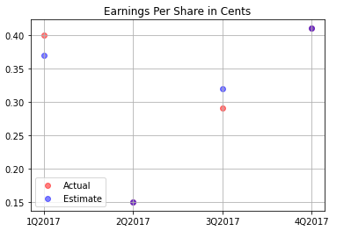
Performance of the Earnings Per Share (EPS) (2017)
EPS exceeded Yahoo estimation in Q1
Yahoo estimation was accurate for Q2 and Q4
EPS below Yahoo estimation in Q3

Slide 5
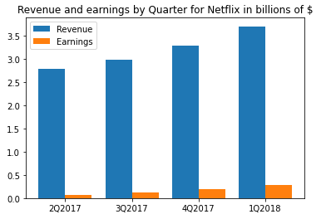
Netflix's Earnings and Revenue in the last four Quarters (2017)
Revenue and earnings have both increased over the quarters
Roughly, 5% of the revenue comprises of earnings

Slide 6
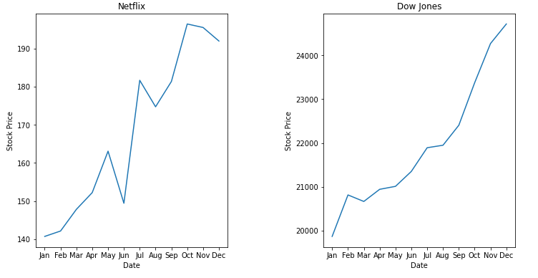
Netflix Stock Price vs Dow Jones Industrial Average (2017)
Netflix performed relatively similar to the DOW.
Netflix’s stock however was more volatile in relation to the DOW.
The DOW’s overall price is much larger, but this is to be expected.

